Slide 1
Data
bb~ and dark jets 58K training examples and 30K test examples each.
Jet radius = 0.7.
Dark pion decay length = 0.5 mm.

Slide 2
Jet representation
Ten vertices with shortest displacement are extracted from each jet.
The data fields for each vertex are: vertex displacement, vertex multiplicity, and the magnitude of the vector sum of constituent PT.
For jets with n_vert<10 the missing entries are masked with -10.0.
No feature scaling or centering was used.

Slide 3
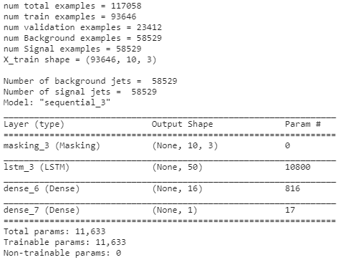
LSTM architecture
Masking layer.
Single LSTM layer.
Two dense layers.
No regularization.

Slide 4
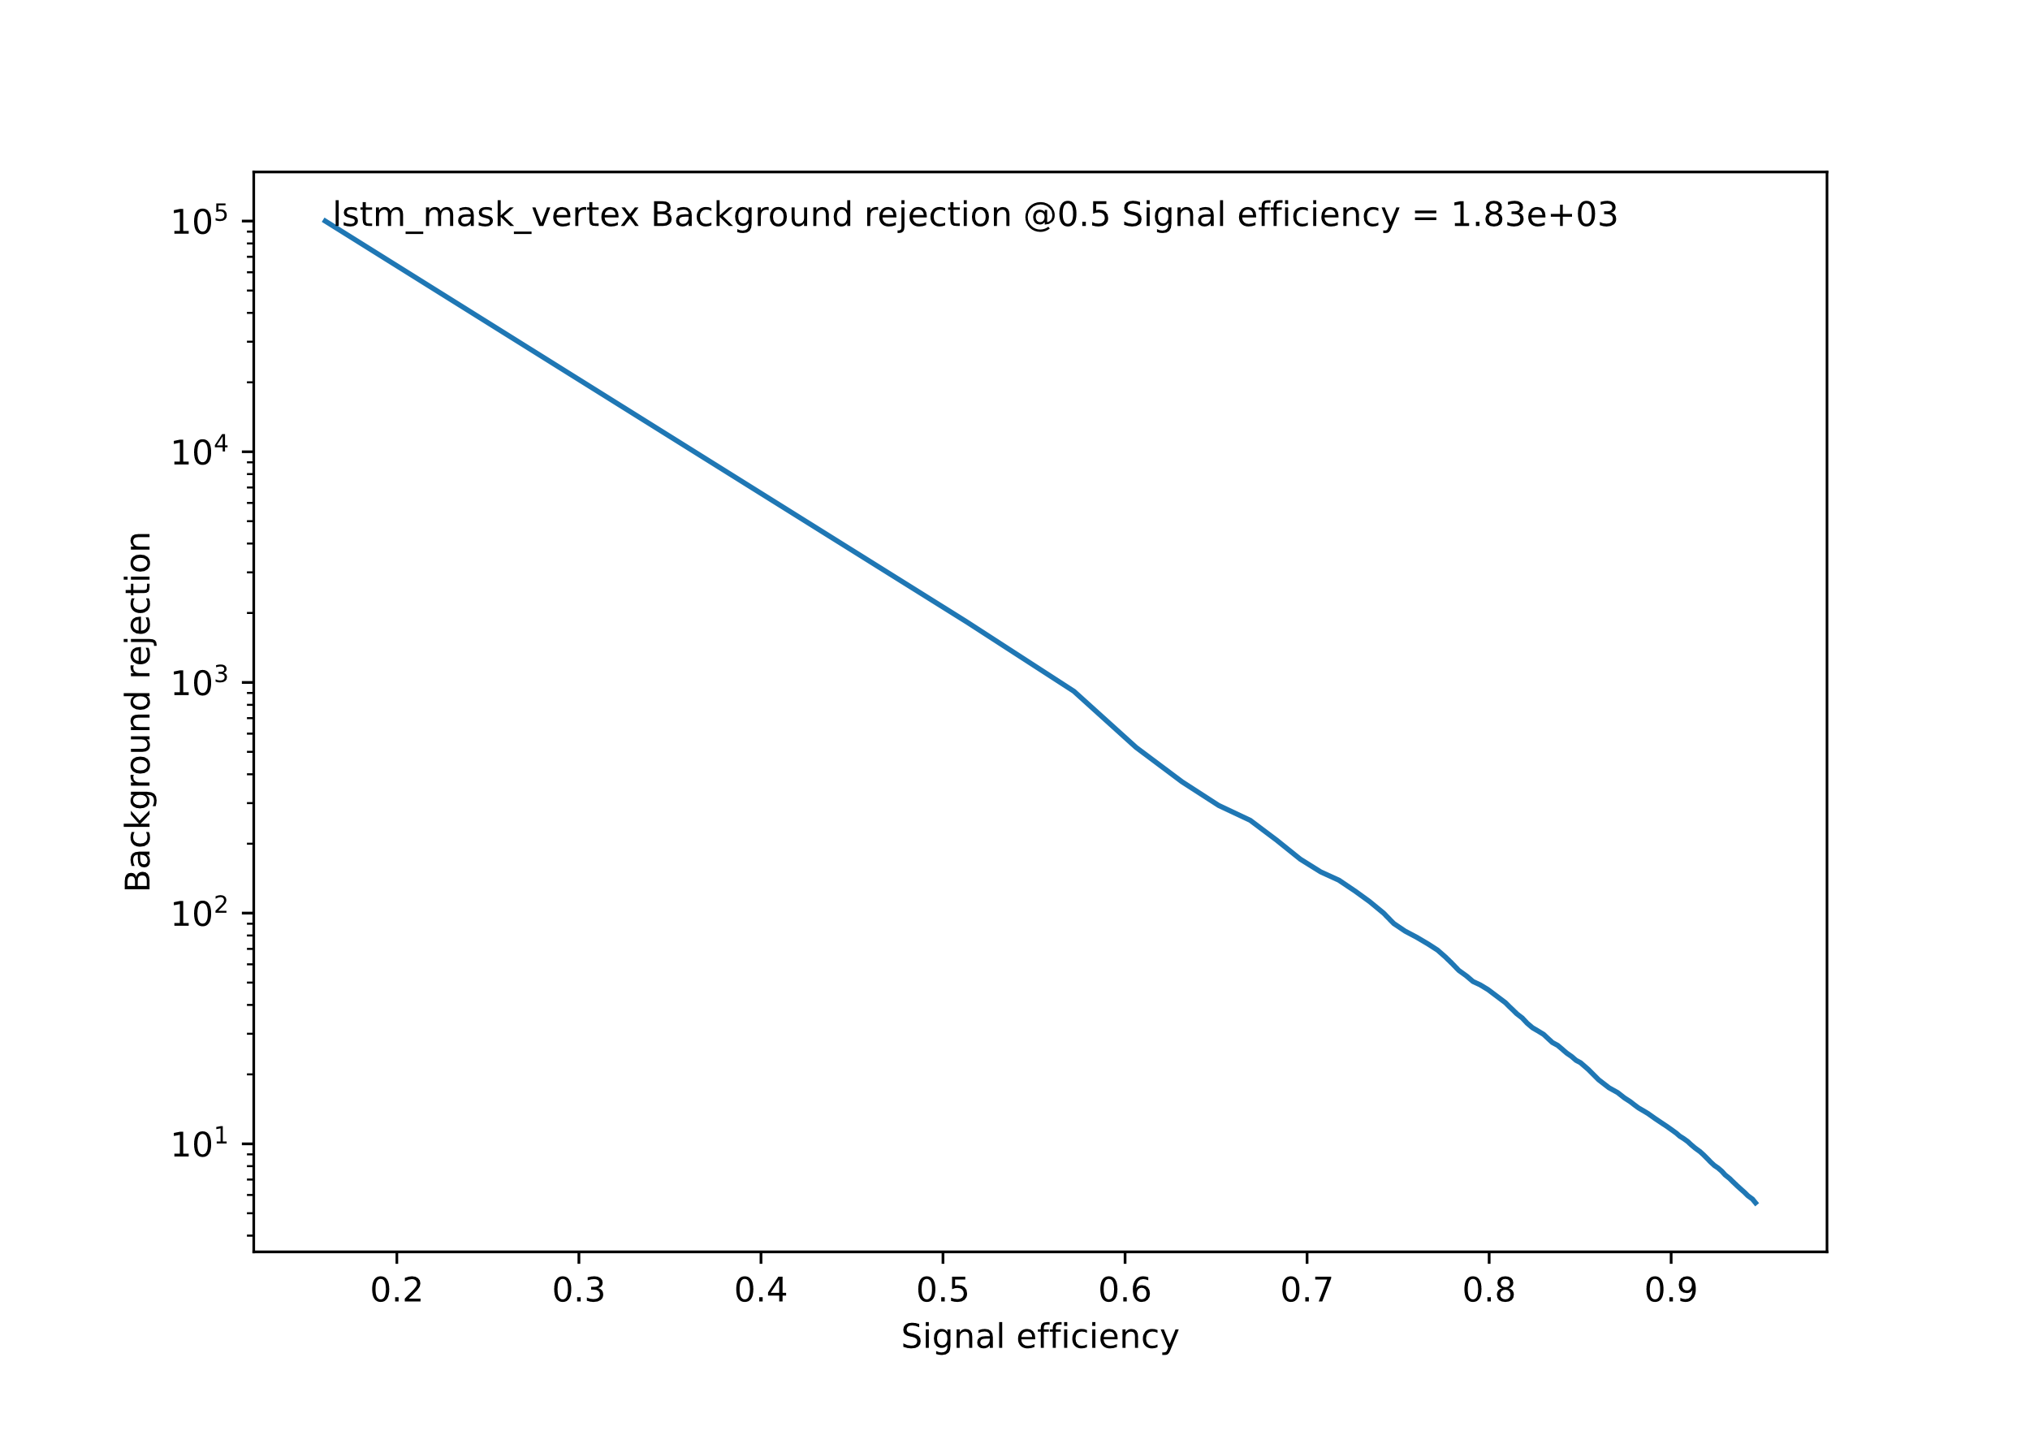
Results

